Slide 1
SEMICONDUCTORS
Dr. Archana Sharma

Slide 2
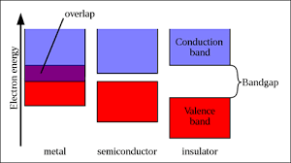
STATES OF MATTER
Solids
Liquids
Gas
Conductors
Semiconductors
Insulators
Band Gap values
Conductors: VB and CB overlaps
Semiconductors: ~1-3 eV
Insulators: > 5eV

Slide 3
DOPING IN SEMICONDUCTORS
Semiconducting materials are very sensitive to impurities in the crystal lattice.
The controlled addition of these impurities is known as doping.
Allows the tuning of the electronic properties: technological applications.
Pure semiconductor are called ‘intrinsic’.
Introduction of dopants →’extrinsic semiconductors’.
Introduction of dopants → (i) new intra-band, energy levels
(ii) Generation of positive or negative charge carriers.

Slide 4
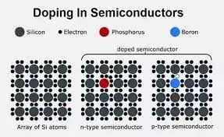
Extrinsic Semiconductors-
(i) n-type: Pentavalent impurity- electrons as majority charge carriers (Donor Atoms)
(ii) p-type: Trivalent impurity- holes as majority charge carriers (Acceptor atoms)
https://www.quora.com/Why-is-doping-required-in-a-semiconductor

Slide 5
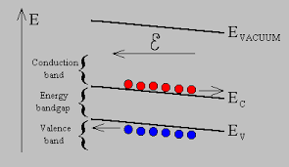
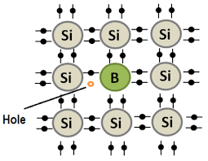
CONCEPT OF HOLES
A hole can be seen as the "opposite" of an electron.
Holes have a positive charge.
They are the absence of an electron in an atom (not physical particles).
They are formed when electrons in atoms move out of the valence band to the conduction band.
Holes can move from atom to atom in semiconducting materials as electrons leave their positions.
https://ecee.colorado.edu/~bart/book/eband4.htm

Slide 6
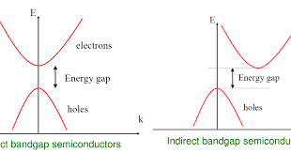
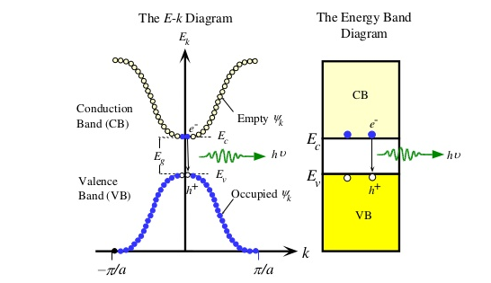
BAND GAP IN SEMICONDUCTORS
Direct gap is important in optoelectronics as direct band gap materials have efficient radiative absorption and emission, which is what makes LEDs and laser diodes work
An E-k diagram shows characteristics of a particular semiconductor material.
It shows the relationship between the energy and momentum of available quantum mechanical states for electrons in the material.
http://edetec106.blogspot.com/2016/01/differentiate-between-direct-and.html
https://www.slideshare.net/chinkitkit/chapter-4a-36657201

Slide 7
EFFECTIVE MASS
The effective mass represents the effect of all the internal forces on the motion of the electron in the conduction band.
Assumption: Mass of electron in solid is same as the mass of a free electron.
Experimentally: In some solids, electron mass is more while for some it is less than the free electron mass.
Effective mass: Experimentally determined electron mass.
Reason: Interaction between the drifting electrons and the atoms in the solids.
Sign of effective mass: determined from the sign of curvature of the E-k curve.

Slide 8
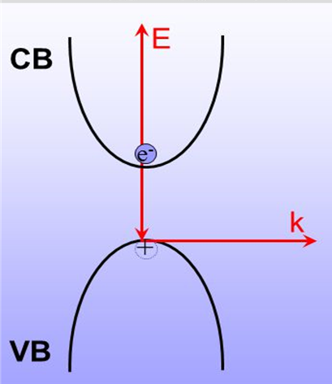
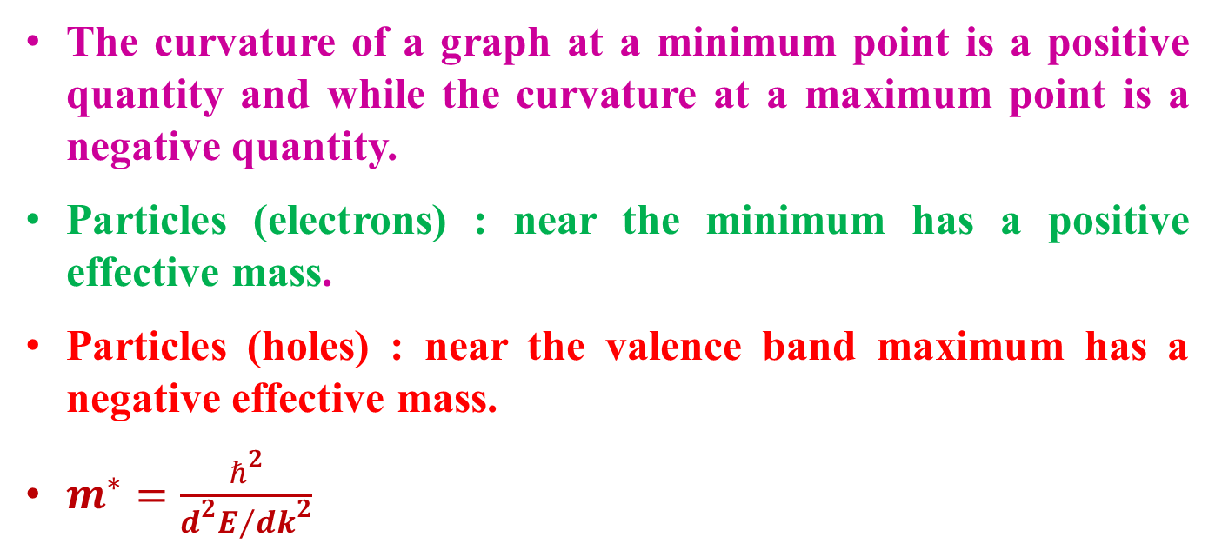
The curvature of a graph at a minimum point is a positive quantity and while the curvature at a maximum point is a negative quantity.
Particles (electrons) : near the minimum has a positive effective mass.
Particles (holes) : near the valence band maximum has a negative effective mass.
$m^{∗}=\frac{ℏ^{2}}{{d^{2}E}/{{dk}^{2}}}$

Slide 9
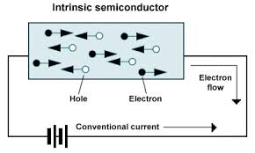
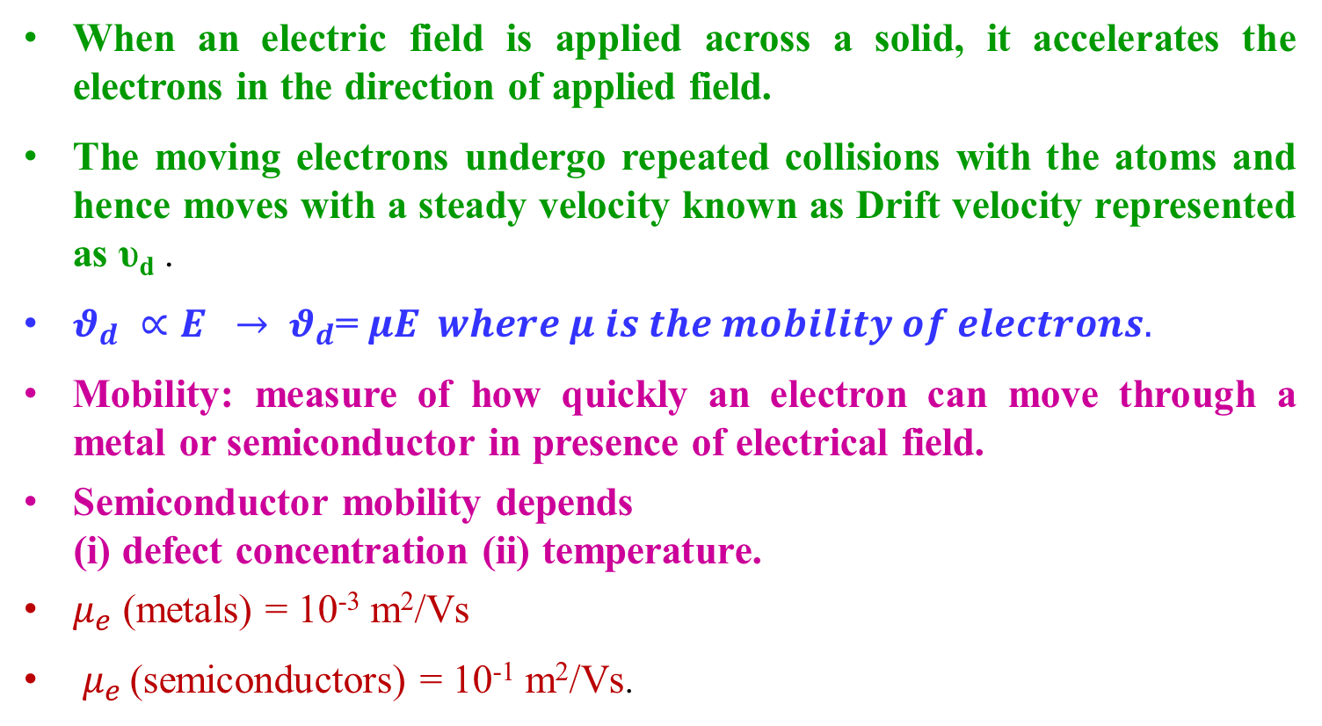
MOBILITY
When an electric field is applied across a solid, it accelerates the electrons in the direction of applied field.
The moving electrons undergo repeated collisions with the atoms and hence moves with a steady velocity known as Drift velocity represented as υ_{d} .
$θ_{d} ∝E → θ_{d}$= $μE where μ is the mobility of electrons.$
Mobility: measure of how quickly an electron can move through a metal or semiconductor in presence of electrical field.
Semiconductor mobility depends
(i) defect concentration (ii) temperature.
$μ_{e}$ (metals) = 10⁻³ m²/Vs
$μ_{e }$(semiconductors) = 10⁻¹ m²/Vs.

Slide 10
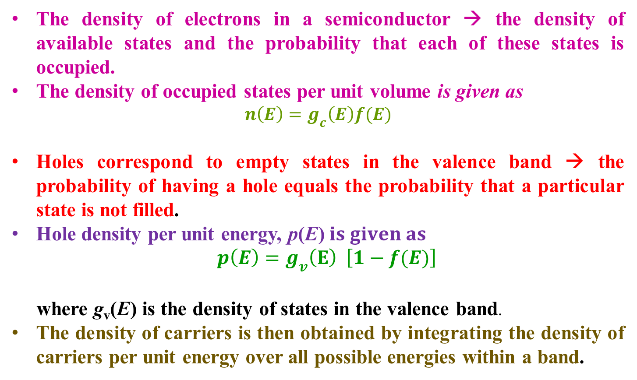
CARRIER CONCENTRATION
The density of electrons in a semiconductor → the density of available states and the probability that each of these states is occupied.
The density of occupied states per unit volume is given as
$$n\left(E\right)=g_{c}\left(E\right)f(E)$$
Holes correspond to empty states in the valence band → the probability of having a hole equals the probability that a particular state is not filled.
Hole density per unit energy, p(E)$is given as$
$$p\left(E\right)=g_{v}\left(E\right) \left[1−f(E)\right]$$
where g_{v}(E) is the density of states in the valence band.
The density of carriers is then obtained by integrating the density of carriers per unit energy over all possible energies within a band.

Slide 11
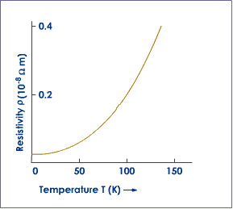
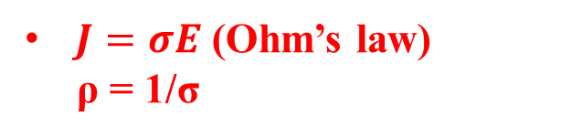
CONDUCTIVITY IN METALS
Conductivity is attributed to free-charge carriers in metals.
Increase in temperature → increases the vibrations of the metal ions.
Increased vibrations → causes frequent collisions between the electrons → drains out energy of the free electrons → restricts the movement of the delocalized electrons → drift velocity decreases → resistivity of the metal increases → current decreases → conductivity of the material decreases.
$J=σE$ (Ohm’s law)
ρ = 1/σ
The temperature dependence is given as
ρ_{t} = ρ₀ [ 1 + α (T – T₀)
https://www.askiitians.com/iit-jee-electric-current/temperature-dependence-of-resistivity/

Slide 12
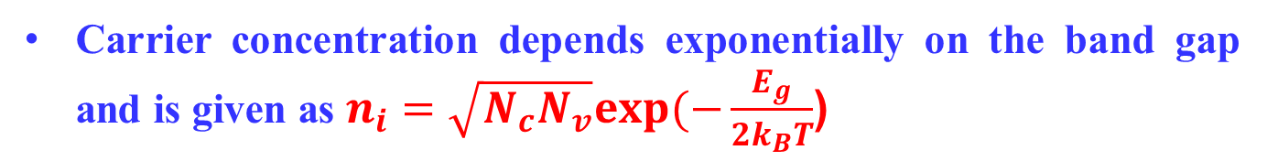
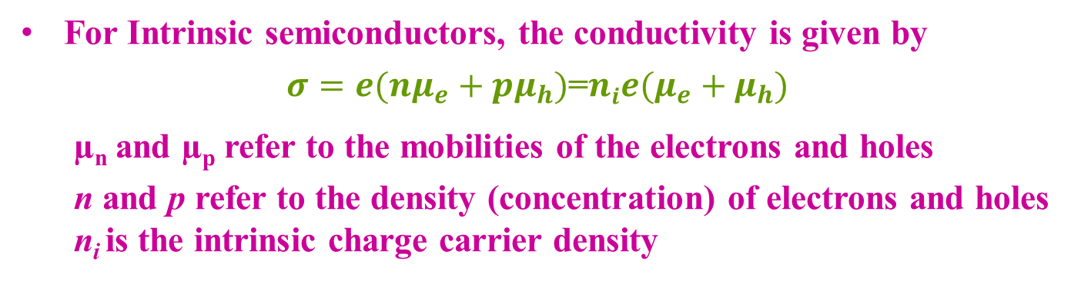
CONDUCTIVITY IN INTRINSIC SC
For Intrinsic semiconductors, the conductivity is given by
$σ=e({nμ}_{e}+pμ_{h})$=$nie(μ_{e}+μ_{h})$
µ_{n} and µ_{p} refer to the mobilities of the electrons and holes
n and p refer to the density (concentration) of electrons and holes
n_{i} is the intrinsic charge carrier density
The electrons in the valance band gains energy → moves to higher energy levels in the conduction band → becomes charge carriers
Carrier concentration depends exponentially on the band gap and is given as $n_{i}=\sqrt{N_{c}N_{v}}exp(−\frac{E_{g}}{2k_{B}T}$)

Slide 13
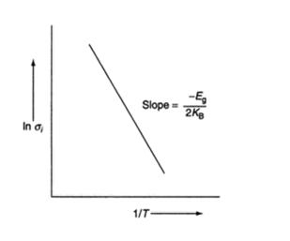
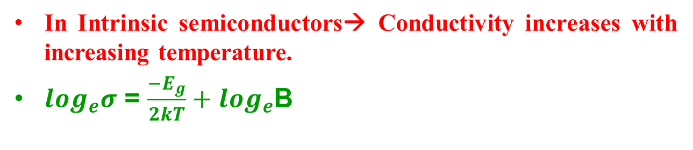
In Intrinsic semiconductors→ Conductivity increases with increasing temperature.
$\log_{e}σ$ = $\frac{{−E}_{g}}{2kT}+\log_{e}$B
https://sites.google.com/site/

Slide 14
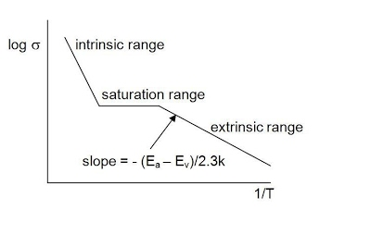
CONDUCTIVITY IN EXTRINSIC SC
Low temperature → frozen charge carriers → resistivity is extremely high.
Moderate increase in temperature → Rapid decrease in resistivity with the increase of ionized charges.
At sufficiently high temperature → dopants are completely ionized → conductivity decreases and the resistivity increases again.
At still higher temperature → resistivity decreases sharply due to appreciable excitation of all carriers and crossing the energy gap.

Slide 15
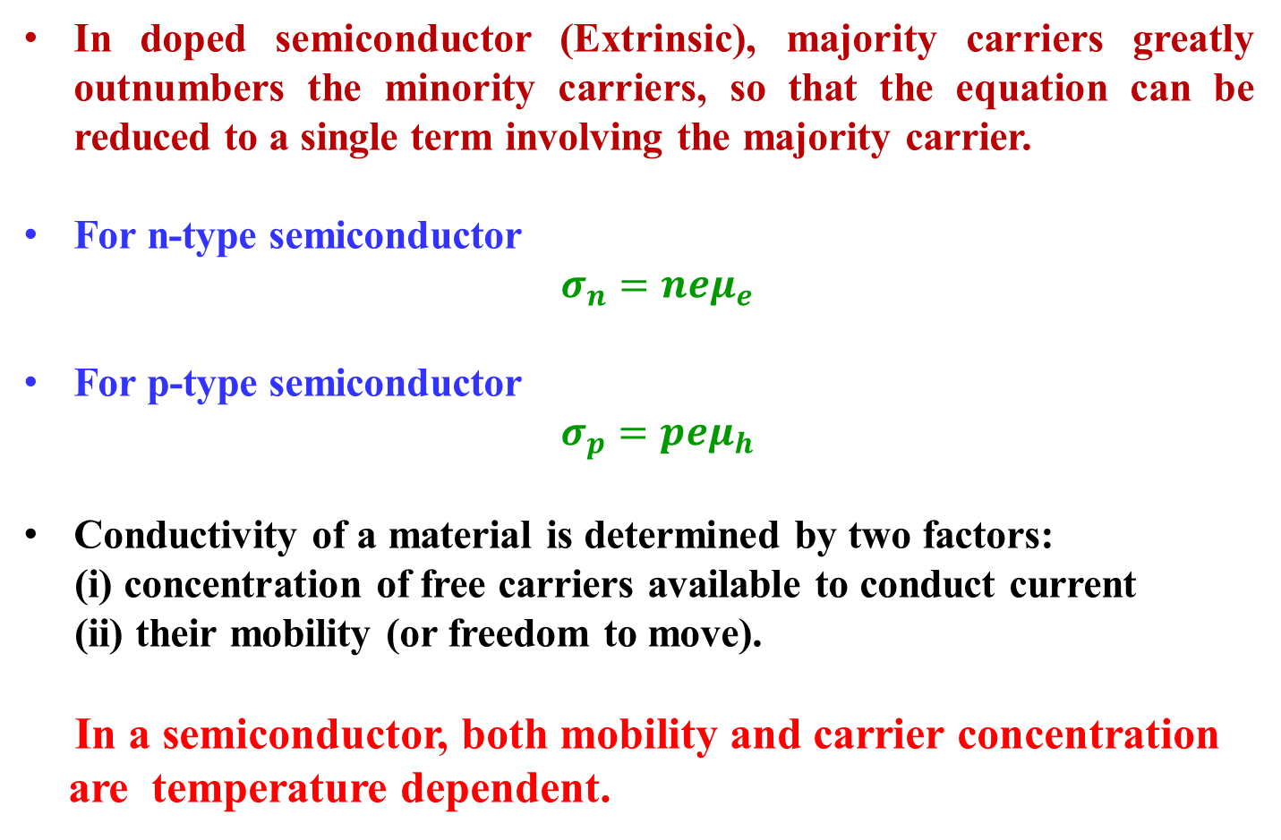
In doped semiconductor (Extrinsic), majority carriers greatly outnumbers the minority carriers, so that the equation can be reduced to a single term involving the majority carrier.
For n-type semiconductor
$σ_{n}=neμ_{e}$
For p-type semiconductor
$σ_{p}=peμ_{h}$
Conductivity of a material is determined by two factors:
(i) concentration of free carriers available to conduct current
(ii) their mobility (or freedom to move).
In a semiconductor, both mobility and carrier concentration
are temperature dependent.

Slide 16
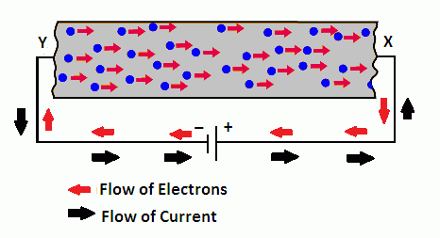
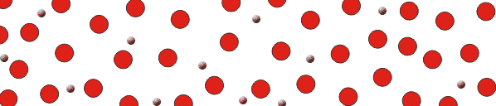
DRIFT CURRENT
Absence of field: free electrons move in a conductor with random velocities and random directions.
Presence of field: the randomly moving electrons experience an electrical force in the direction of the field.
Electrons shift towards higher potential with their random motion.
The electrons will drift towards higher potential along with their random motions.
https://web2.ph.utexas.edu/~coker2/index.files/current.htm

Slide 17
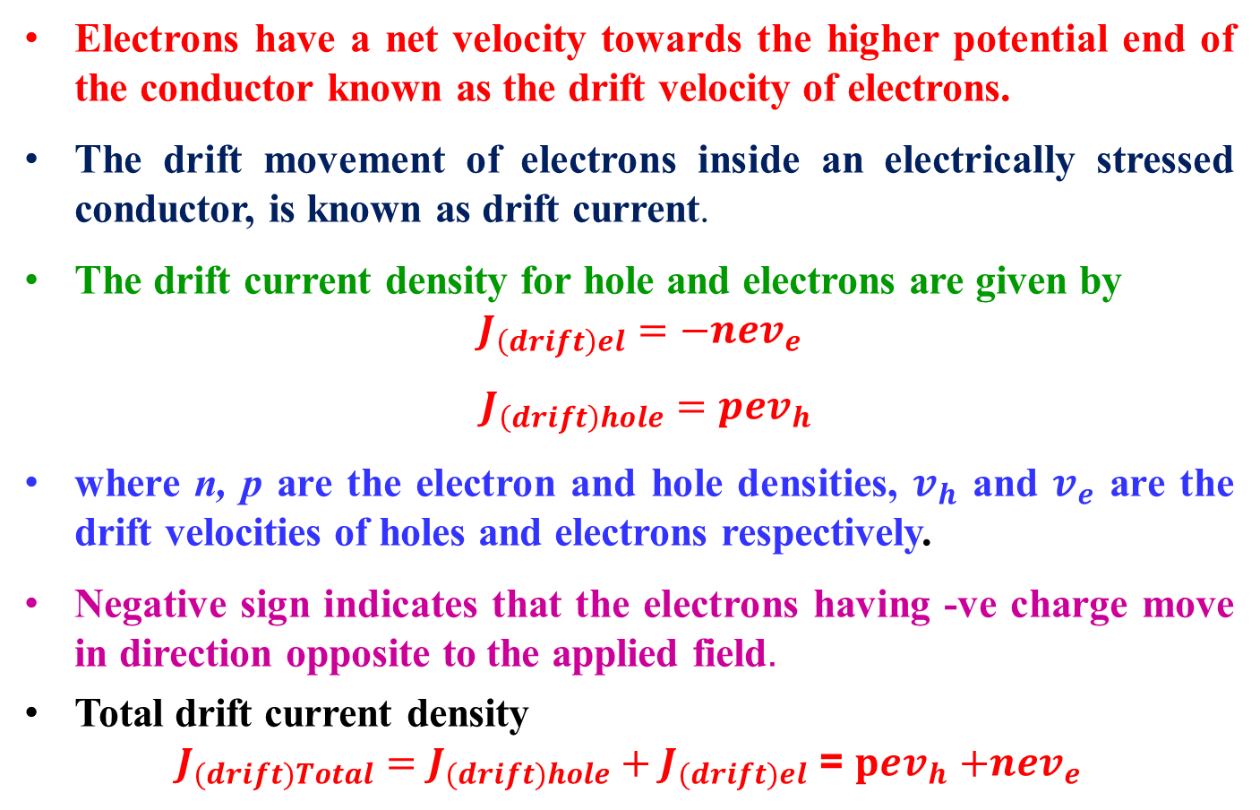
Electrons have a net velocity towards the higher potential end of the conductor known as the drift velocity of electrons.
The drift movement of electrons inside an electrically stressed conductor, is known as drift current.
The drift current density for hole and electrons are given by $J_{\left(drift\right)el}=−nev_{e}$
$J_{\left(drift\right)hole}=pev_{h}$
where n, p are the electron and hole densities, $v_{h}$ and $v_{e}$ are the drift velocities of holes and electrons respectively.
Negative sign indicates that the electrons having -ve charge move in direction opposite to the applied field.
Total drift current density
$J_{(drift)Total}=J_{(drift)hole}+J_{(drift)el}$ = $pev_{h}$ $+{nev}_{e}$

Slide 18
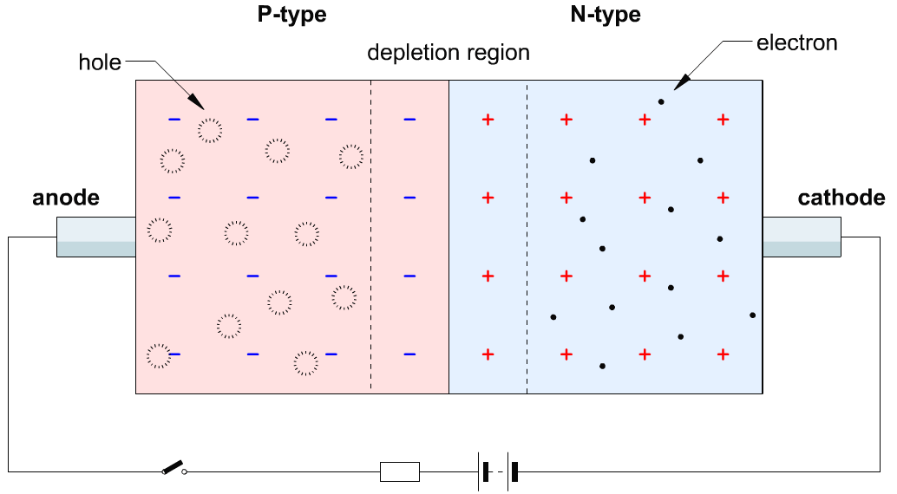
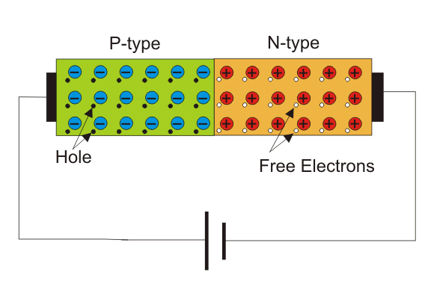
DIFFUSION CURRENT
In semiconducting material → Dopants are introduced to some region → even distribution of carriers takes place to maintain the uniformity → known as diffusion process
Movement of the mobile charge carriers are responsible for the flow of diffusion current from one region to the other.
No source of energy is required diffusion current.
http://semesters.in/v-i-characteristics-of-p-n-junction-diode-notes-for-electronics-engineering

Slide 19
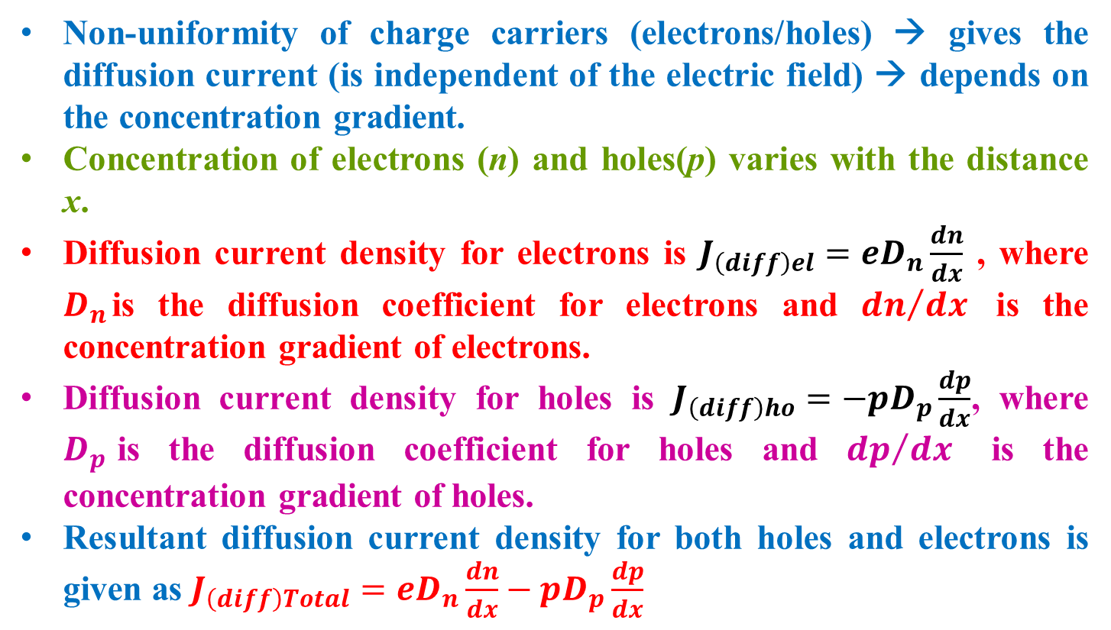
DIFFUSION CURRENT
Non-uniformity of charge carriers (electrons/holes) → gives the diffusion current (is independent of the electric field) → depends on the concentration gradient.
Concentration of electrons (n) and holes(p) varies with the distance x.
Diffusion current density for electrons is $J_{\left(diff\right)el}=eD_{n}\frac{dn}{dx}$ , where $D_{n}$is the diffusion coefficient for electrons and ${dn}/{dx}$ is the concentration gradient of electrons.
Diffusion current density for holes is $J_{\left(diff\right)ho}=−pD_{p}\frac{dp}{dx}$, where $D_{p}$is the diffusion coefficient for holes and ${dp}/{dx}$ is the concentration gradient of holes.
Resultant diffusion current density for both holes and electrons is given as $J_{\left(diff\right)Total}={eD}_{n}\frac{dn}{dx}−pD_{p}\frac{dp}{dx}$

Slide 20
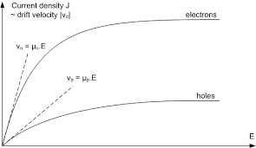
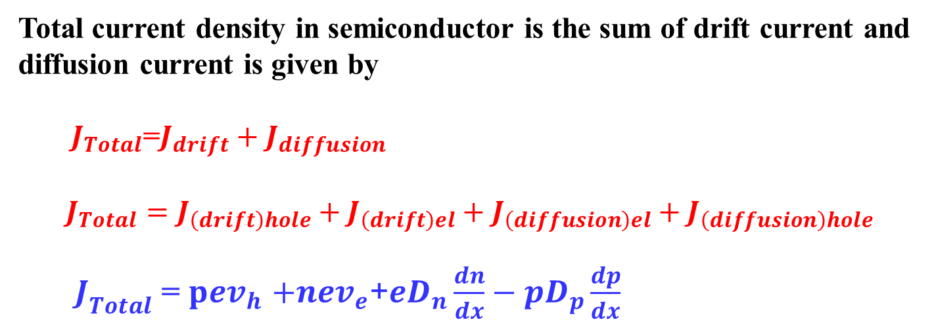
TOTAL CURRENT DENSITY
Total current density in semiconductor is the sum of drift current and diffusion current is given by
${ J}_{Total}$=$J_{drift}+J_{diffusion}$
$$J_{Total}=J_{\left(drift\right)hole}+J_{\left(drift\right)el}+J_{\left(diffusion\right)el}+J_{\left(diffusion\right)hole}$$
$J_{Total}$ = $pev_{h}$ $+{nev}_{e}$+${eD}_{n}\frac{dn}{dx}−pD_{p}\frac{dp}{dx}$
Figure shows the plot for the current density J_{drift} and the absolute value of the drift velocity, over the electric field E. The mobility of holes and electrons can be evaluated using the tangential of the drift velocity.
http://lamp.tu-graz.ac.at/~hadley/psd/problems/diffusioncurrent2/s.pdf

Slide 21
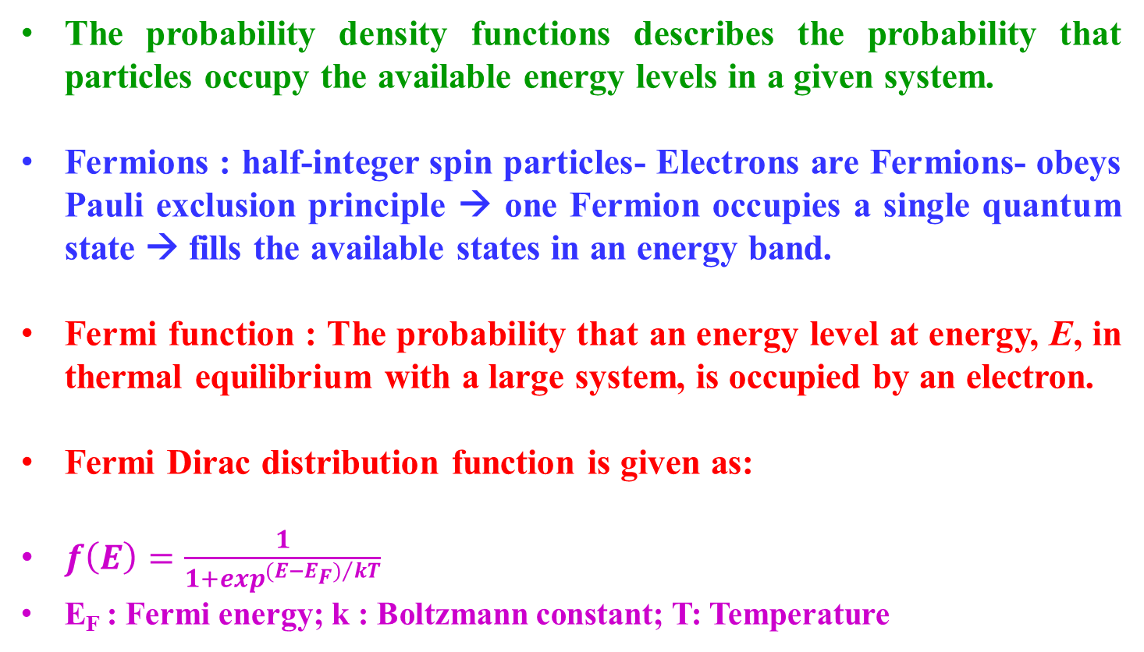
FERMI DIRAC DISTRIBUTION FUNCTION
The probability density functions describes the probability that particles occupy the available energy levels in a given system.
Fermions : half-integer spin particles- Electrons are Fermions- obeys Pauli exclusion principle → one Fermion occupies a single quantum state → fills the available states in an energy band.
Fermi function : The probability that an energy level at energy, E, in thermal equilibrium with a large system, is occupied by an electron.
Fermi Dirac distribution function is given as:
$f\left(E\right)=\frac{1}{1+\exp^{{(E−E_{F})}/{kT}}}$
E_{F} : Fermi energy; k : Boltzmann constant; T: Temperature

Slide 22
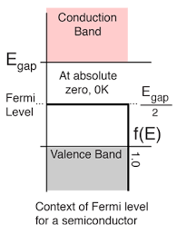
WHAT IS FERMI LEVEL
The highest energy level that an electron occupies at the absolute zero temperature is known as the Fermi Level.
The Fermi level lies between the valence band and conduction band. At T=0 K, the electrons are all in the lowest energy state → Fermi level can be considered as the sea of fermions (or electrons) above which no electrons exist.
The Fermi level changes as the temperature increases or electrons are added to or withdrawn from the solids.

Slide 23
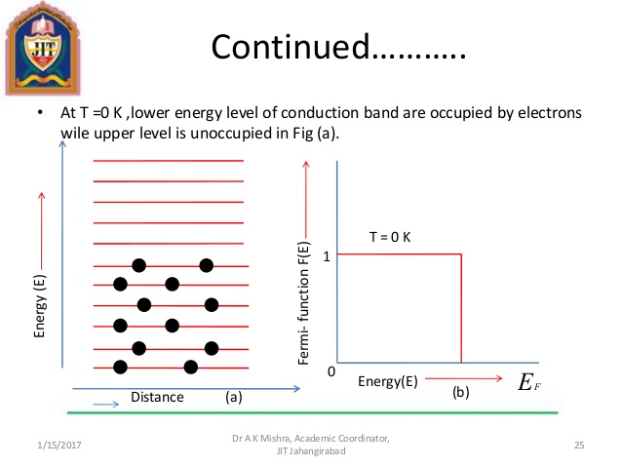
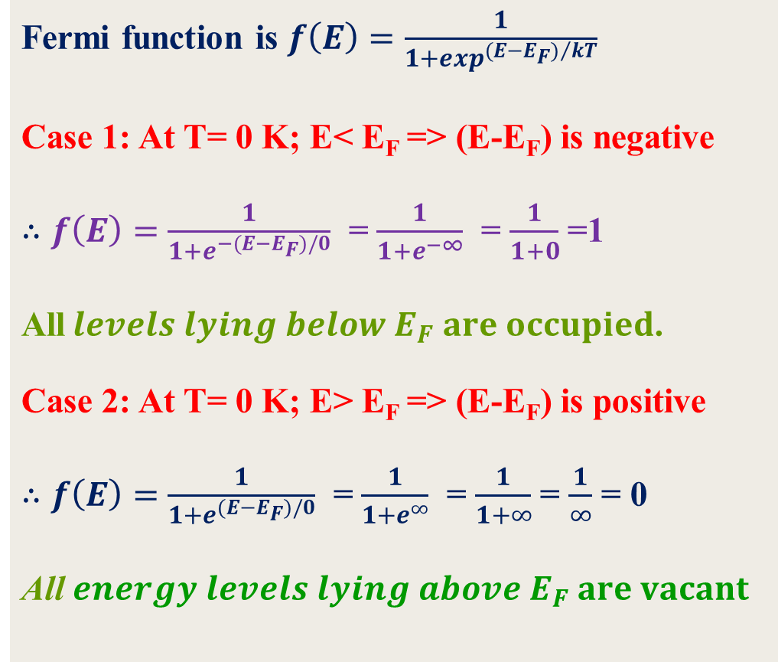
FERMI LEVEL IN A CONDUCTOR
Fermi function is $f\left(E\right)=\frac{1}{1+\exp^{{(E−E_{F})}/{kT}}}$
Case 1: At T= 0 K; E< E_{F} => (E-E_{F}) is negative
$∴f\left(E\right)=\frac{1}{1+e^{−(E−E_{F})/0}}$ = $\frac{1}{1+e^{−∞}}$ = $\frac{1}{1+0}$ =1
All$levels lying below E_{F} are occupied$.
Case 2: At T= 0 K; E> E_{F} => (E-E_{F}) is positive
$∴f\left(E\right)=\frac{1}{1+e^{(E−E_{F})/0}}$ = $\frac{1}{1+e^{∞}}$ = $\frac{1}{1+∞}$ = $\frac{1}{∞}$ = 0
All $energy levels lying above E_{F} are vacant$

Slide 24

What happens to the fermi level at high temperature ?

Slide 25
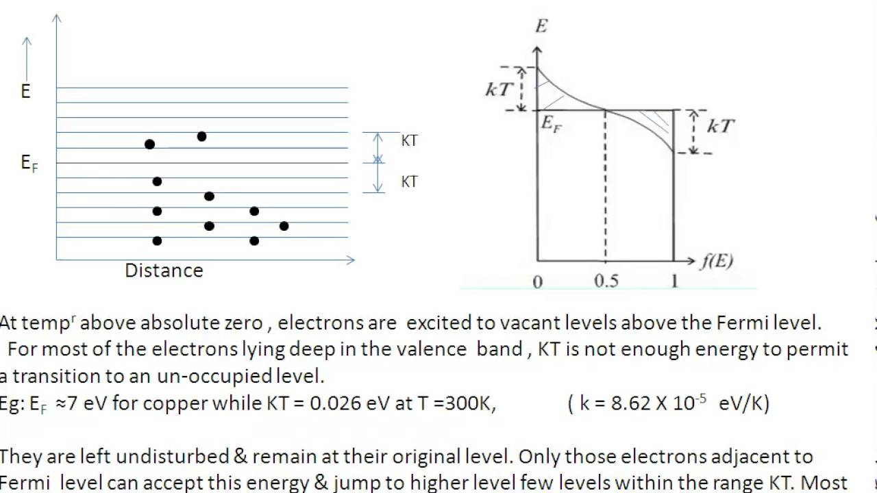
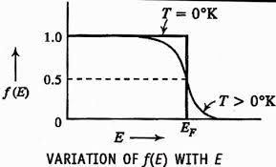
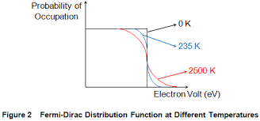
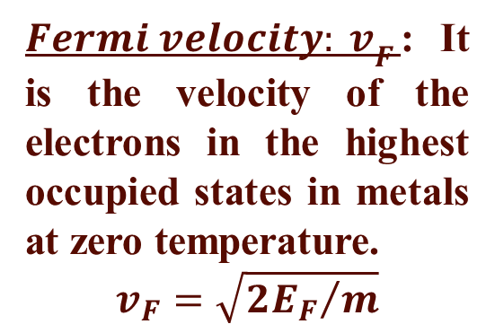
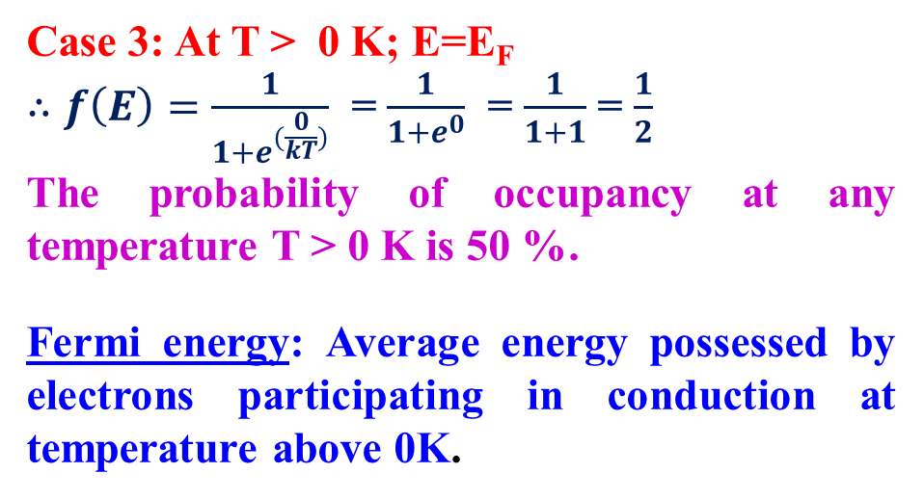
Case 3: At T > 0 K; E=E_{F}
$∴f\left(E\right)=\frac{1}{1+e^{(\frac{0}{kT})}}$ = $\frac{1}{1+e^{0}}$ = $\frac{1}{1+1}$ = $\frac{1}{2}$
The probability of occupancy at any temperature T > 0 K is 50 %.
Fermi energy: Average energy possessed by electrons participating in conduction at temperature above 0K.
${Fermi velocity: v}_{F}$: It is the velocity of the electrons in the highest occupied states in metals at zero temperature.
$$v_{F}=\sqrt{{2E_{F}}/m}$$
https://www.electrical4u.com/fermi-dirac-distribution-function/

Slide 26
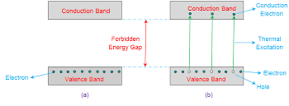
FERMI LEVEL IN INTRINSIC SC
At T=0 K, the valence band will be full of electrons → impossible to cross the energy barrier → acts as an insulator.
At T > 0 K → the electron movement from the valence band to the conduction band increases → create holes in the valence band in place of electrons.
The electron concentration ‘n’ is equal to hole concentration ‘p’.
T= 0K
T > 0K

Slide 27
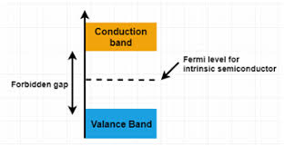


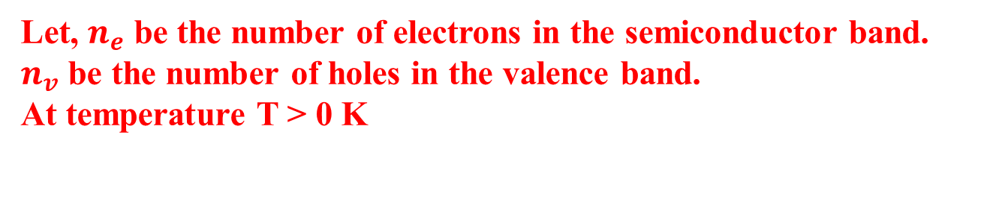
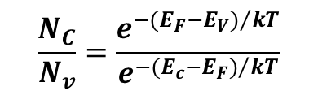
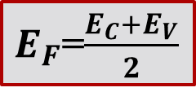
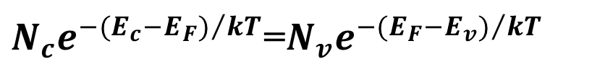

POSITION OF FERMI LEVEL IN INTRINSIC SC
Let, $n_{e}$ be the number of electrons in the semiconductor band.
$n_{v}$ be the number of holes in the valence band.
At temperature T > 0 K
$$n_{e}=N_{c}e^{{−(E_{c}−E_{F})}/{kT}}$$
$$n_{v}=N_{v}e^{{−(E_{F}−E_{V})}/{kT}}$$
$N_{c}$ is the effective density of states in the conduction band and$N_{v}$ is the effective density of states in the valence band. For an intrinsic semiconductor, $n_{e}=n_{v}$
$e^{\frac{−({2E}_{F}−E_{V}−E_{c})}{kT}}$ =1 as $N_{c}=N_{v}$
Taking log on both sides, we get $\frac{E_{c}+E_{v}−{2E}_{F}}{kT}$=0
$∴$ Fermi level in an intrinsic SC →at the centre of the band gap.
$N_{c}e^{{−(E_{c}−E_{F})}/{kT}}$=$N_{v}e^{{−(E_{F}−E_{v})}/{kT}}$
$$\frac{N_{C}}{N_{v}}=\frac{e^{{−(E_{F}−E_{V})}/{kT}}}{e^{{−(E_{c}−E_{F})}/{kT}}}$$
$E_{F}$=$\frac{E_{C}+E_{V}}{2}$

Slide 28
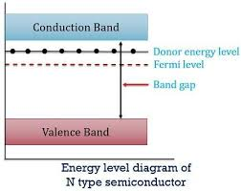
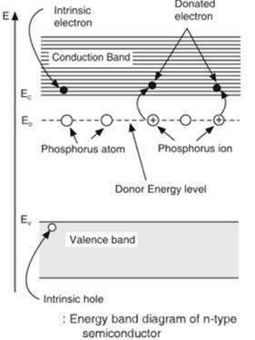
FERMI LEVEL IN EXTRINSIC SC
N-type SC- pentavalent impurity : electrons as majority charge carriers: donor impurities
https://sites.google.com/site/puenggphysics/home/unit-5/fermi-level-of-extrinsic-semiconductor

Slide 29
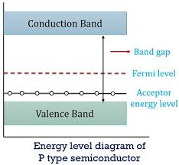
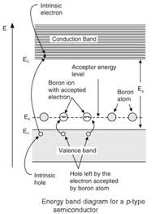
FERMI LEVEL IN EXTRINSIC SC
P-type SC- trivalent impurity : holes as majority charge carriers: acceptor impurities
https://sites.google.com/site/puenggphysics/home/unit-5/fermi-level-of-extrinsic-semiconductor

Slide 30
EFFECT OF TEMPERATURE ON THE
FERMI LEVEL OF N-TYPE
SEMICONDUCTOR

Slide 31
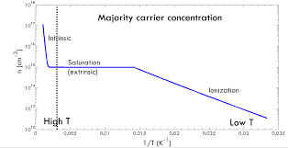
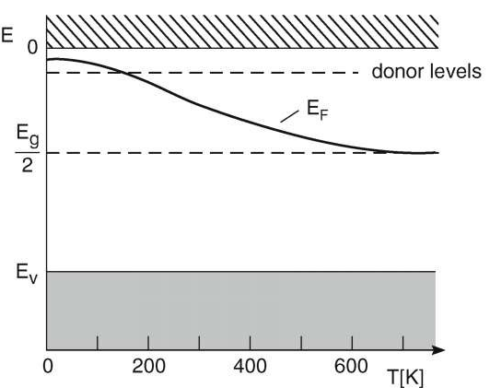
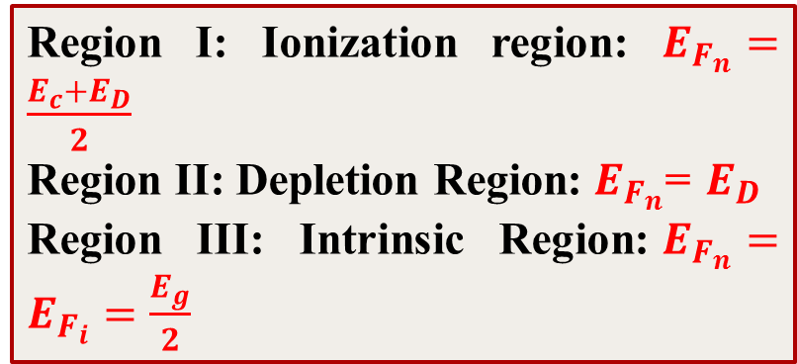

EFFECT OF TEMPERATURE ON E_{F} OF N- TYPE SC
Intrinsic
Depletion
Ionization
Region I: Ionization region: $E_{F_{n}}=\frac{E_{c}+E_{D}}{2}$
Region II: Depletion Region:${ E}_{F_{n}}$= $E_{D}$
Region III: Intrinsic Region:$E_{F_{n}}=E_{F_{i}}=\frac{E_{g}}{2}$
Fermi level position in n type semiconductor with respect to intrinsic Fermi level is given as
$$E_{F_{n}}−E_{F_{i}}=k_{B}T\ln{\frac{n}{n_{i}}}$$
https://nptel.ac.in/content/storage2/courses/113106062/Lec7.pdf

Slide 32
EFFECT OF TEMPERATURE ON THE
FERMI LEVEL OF P-TYPE
SEMICONDUCTOR

Slide 33



EFFECT OF TEMPERATURE ON E_{F} OF P- TYPE SC
Region 1: Ionization region: $E_{F_{p}}=\frac{E_{V}+E_{A}}{2}$
Region 2: Depletion Region: $E_{F_{p}}$= $E_{A}$
Region 3: Intrinsic Region $:E_{F_{p}}=E_{F_{i}}=\frac{E_{g}}{2}$
Fermi level position in p type semiconductor with respect to intrinsic Fermi level is given as
$$E_{F_{P}}−E_{F_{i}}=−k_{B}T\ln{\frac{p}{n_{i}}}$$
https://nptel.ac.in/content/storage2/courses/113106062/Lec7.pdf

Slide 34

EFFECT OF IMPURITY CONCENTRATION ON E_{F} OF N- TYPE SC
(a)
A book of Engineering Physics by Avadhanulu and Kshirsagar

Slide 35

EFFECT OF IMPURITY CONCENTRATION ON E_{F} OF P- TYPE SC
A book of Engineering Physics by Avadhanulu and Kshirsagar

Slide 36
DOUBTS IF ANY?????
THANK YOU

